Slide 1
Social Network Integration
Chapter 21

Slide 2
Objectives
1
2
Social Networks
Social Network Integration
3
4
Monetizing your site with Ads
Marketing Campaigns
5
Working in Web Development

Slide 3
Social Networks
Section 1 of 5

Slide 4
Modern Social Networks
Social networks are web-based systems designed to bring people together by facilitating the exchange of text snippets, photos, links, and other content with other users.
Famous networks include Facebook, Twitter, MySpace, LinkedIn, and Google+, among a sea of others.
Social networks are an area of study that predate digital social networking platforms and even the WWW.

Slide 5
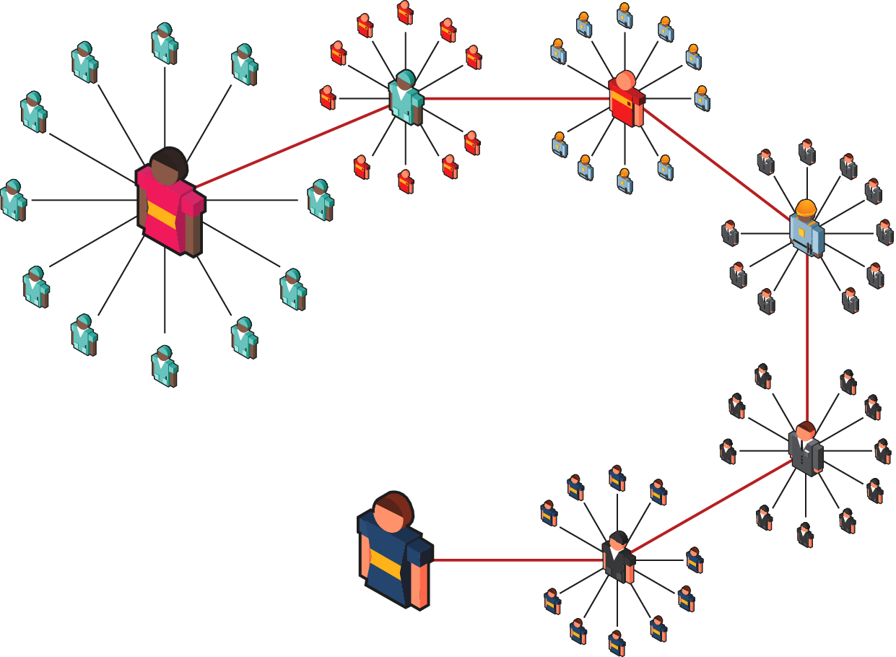
Social Networks
6 degrees of separation

Slide 6
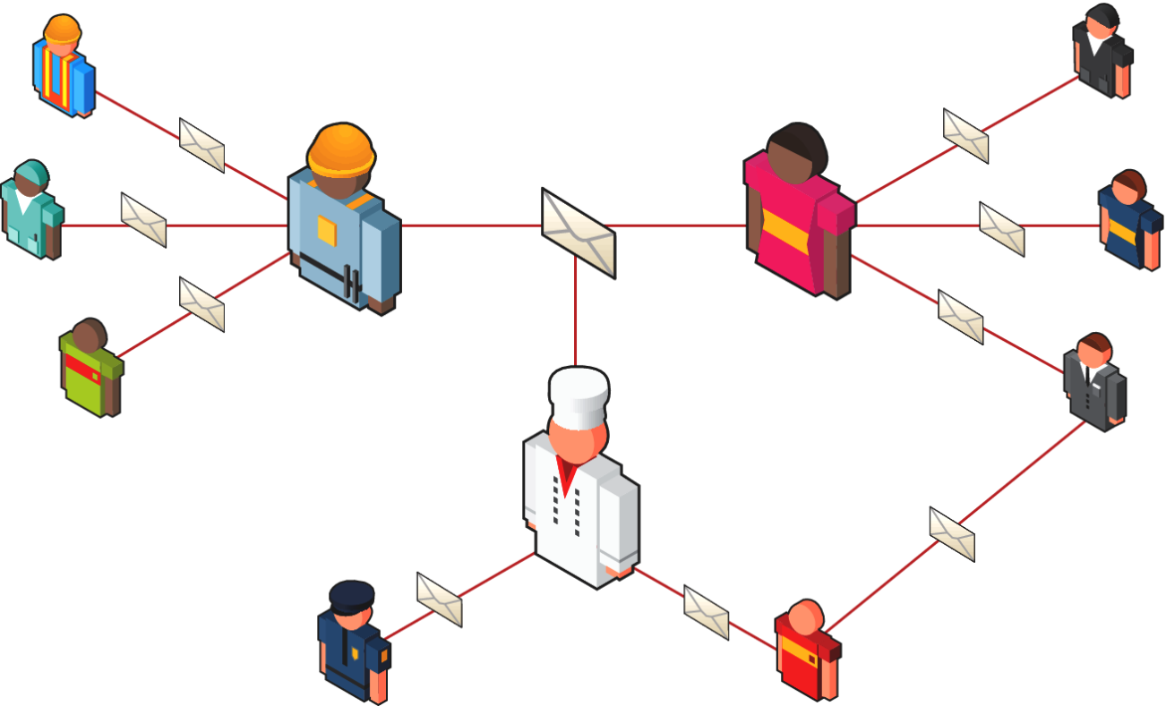
Early Digital Networking
The good ol days
Email, allows for the management of your social network done through conversations. CC fields and mailing lists introduce more social aspects, but your contacts are not visible to people you email.

Slide 7
Early Digital Networking
The good ol days
The first open-spirited means of digital communication were bulletin board systems (BBS)
Unlike email, these systems were wide open and all communication was visible to anyone.
The problem with the networks of email and bulletin board is that neither approximates the real-world networks we naturally maintain

Slide 8
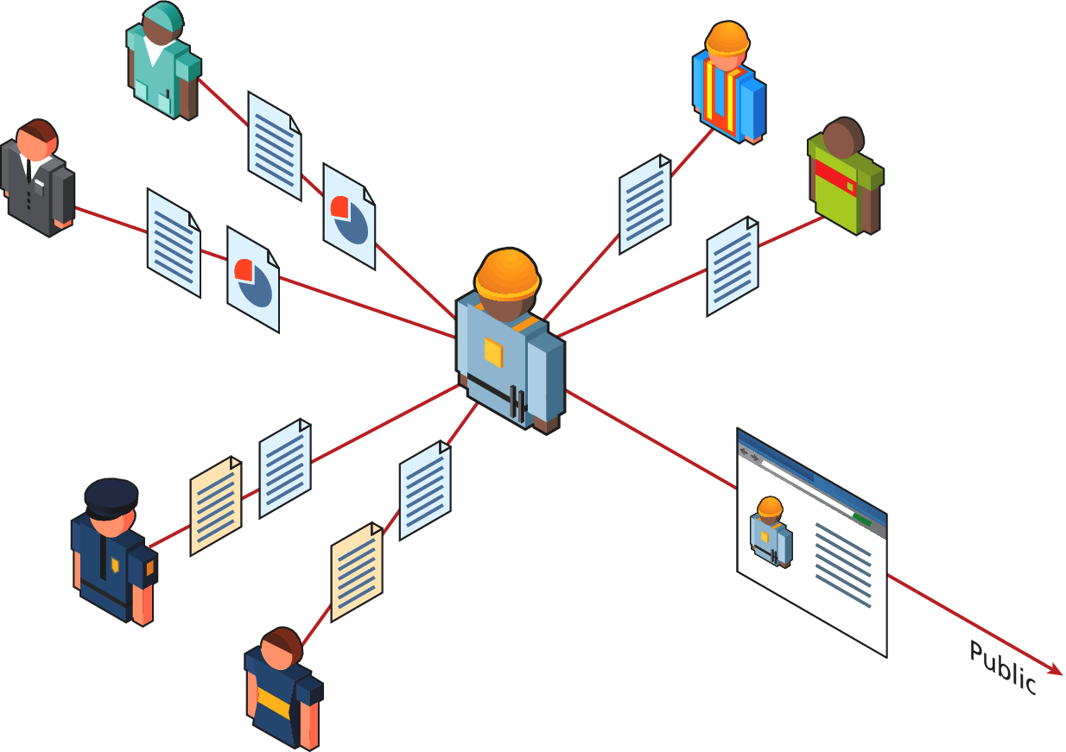
Modern Digital Networking
The birth of
Between public services like BBS and private systems like email there is a gap in services, which social networking sites aim to fill.

Slide 9
Modern Digital Networking
Common characteristics
All social networks share some common characteristics:
Free Registration
User Profile Page
Manage contacts
Beyond the Web Portal APIs
Monetization

Slide 10
Social Network Integration
Section 2 of 5

Slide 11
Basic Social Media Presence
Social lowers the barriers to entry for people who would never want to maintain an HTML page.
Home Pages
Every person, company, hobby, or group wants or needs a home page somewhere on the web, and a social network presence provides a presence that is easy to set up and manage, even for nontechnical people.

Slide 12
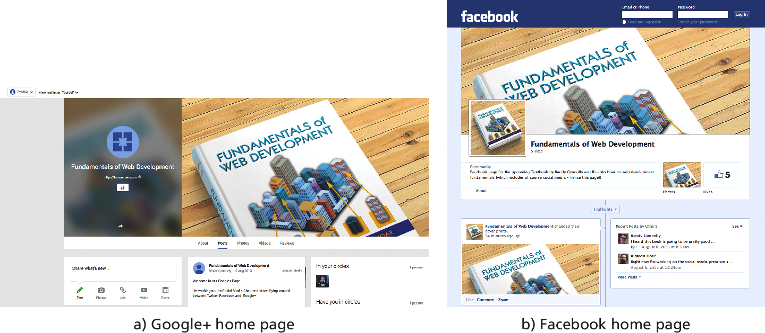
Basic Social Media Presence
Social media pages for this book

Slide 13
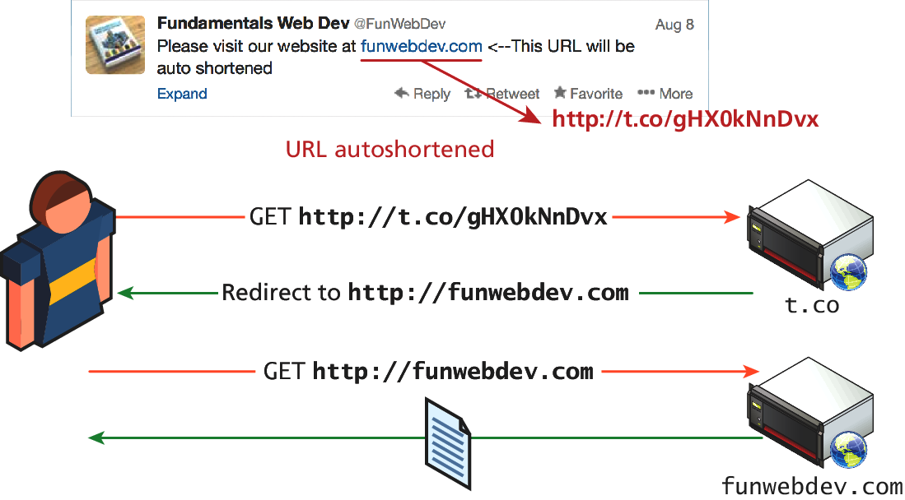
Basic Social Media Presence
URL shortening
In social networks like Twitter shorter URLs are preferable to long URLs, since they leave more room for other content.

Slide 14
Facebook’s Social Plugins
Back to code
Facebook’s social plugins include a wide range of things you’ve probably seen before including the Like button, an activity feed, and comments.
Facebook supports numerous methodologies including:
HTML5,
the Facebook Markup Language (XFBML), or
an <iframe> implementation

Slide 15
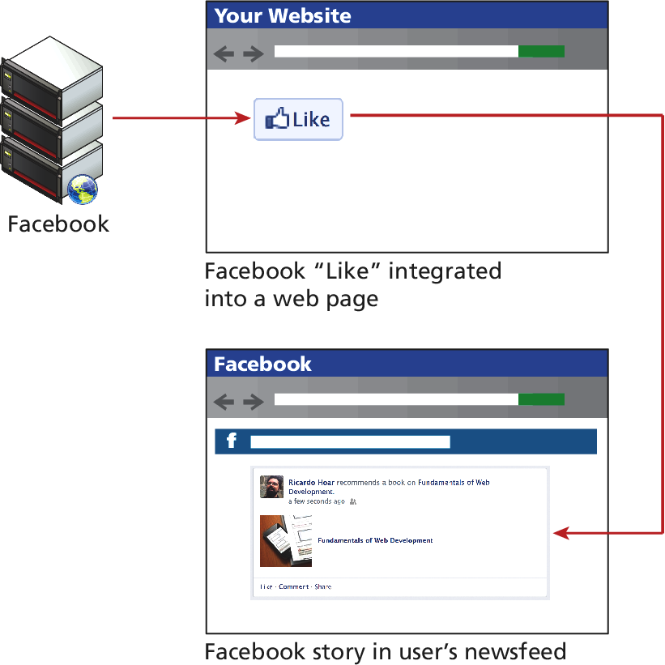
Facebook’s Social Plugins
What is a like anyhow?

Slide 16
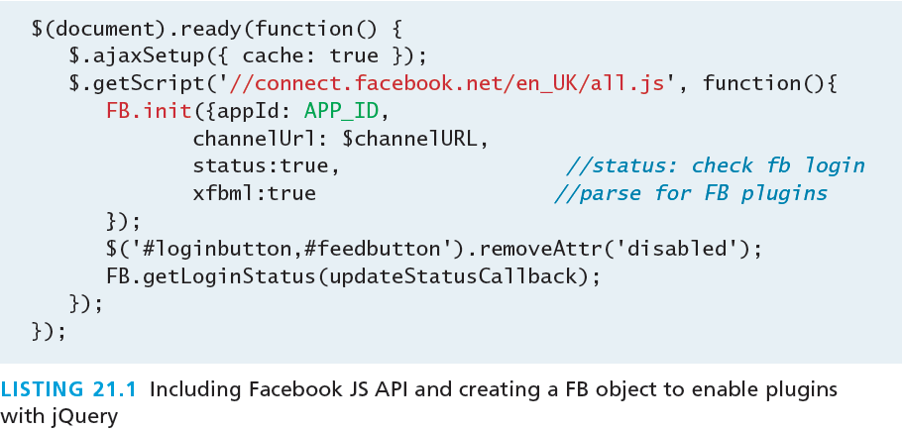
Facebook’s Social Plugins
First Steps
To use the Facebook libraries in your website in the long term, you will have to first register as a developer and get an application ID. Using your APP_ID, you can include Facebook’s JavaScript libraries in your site.

Slide 17
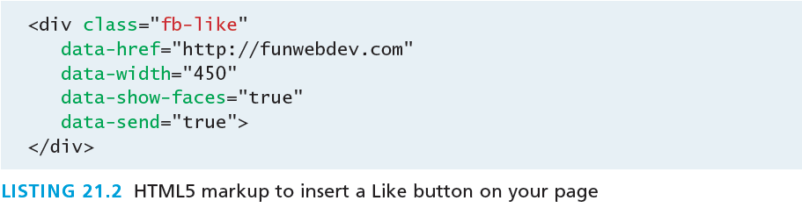
Facebook’s Social Plugins
The like Button
The Facebook JavaScript classes parse your HTML page for certain tags, and replace them with common plugins.
The Like button, can be included simply by defining a <div> element with the class fb-like

Slide 18
Facebook’s Social Plugins
The like Button
How the like appears on the liker’s wall depends on the scraping that was done by Facebook
To control what Facebook uses when displaying items in your newsfeed, you must use Open Graph semantic tags to create Open Graph Objects in your HTML pages

Slide 19
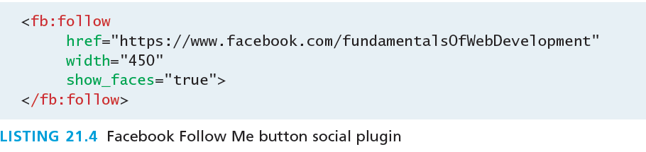
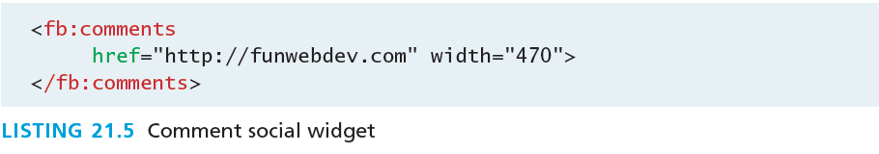
Facebook’s Social Plugins
Follow Button
The Follow Me button allows a Facebook user to follow a Facebook page

Slide 20
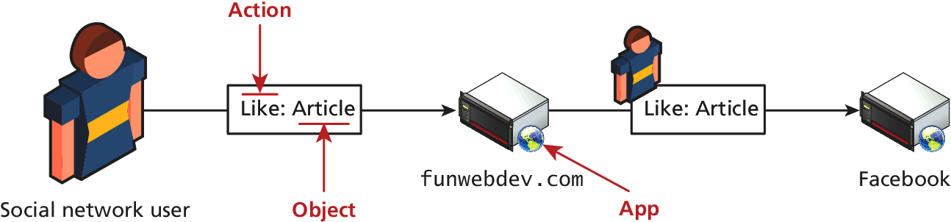
Open Graph
Semantic stuff
Open Graph (OG) is an API originally developed by Facebook, which is designed to add semantic information about content as well as provide a way for plugin developers to post into Facebook as registered users.

Slide 21
Open Graph
Semantic stuff
Open Graph makes use of actors, apps, actions, and objects
The actor is the user logged in to Facebook, perhaps clicking on your Like button.
The app is preregistered by the developer with Facebook.
The actions in Open Graph are the things users can do, for example, post a message, like a page, or comment on an article.
Objects are web pages, but they have additional semantic markup to give insight into what the web page is about.

Slide 22
Open Graph
the Facebook Open Graph Object debugger
https://developers.facebook.com/tools/debug/og/object?q=YOURURL

Slide 23
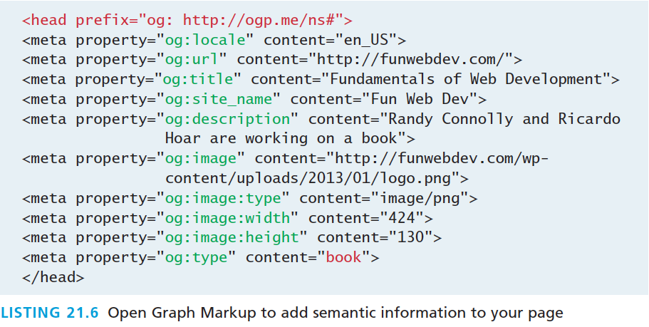
Open Graph
Meta Tags

Slide 24
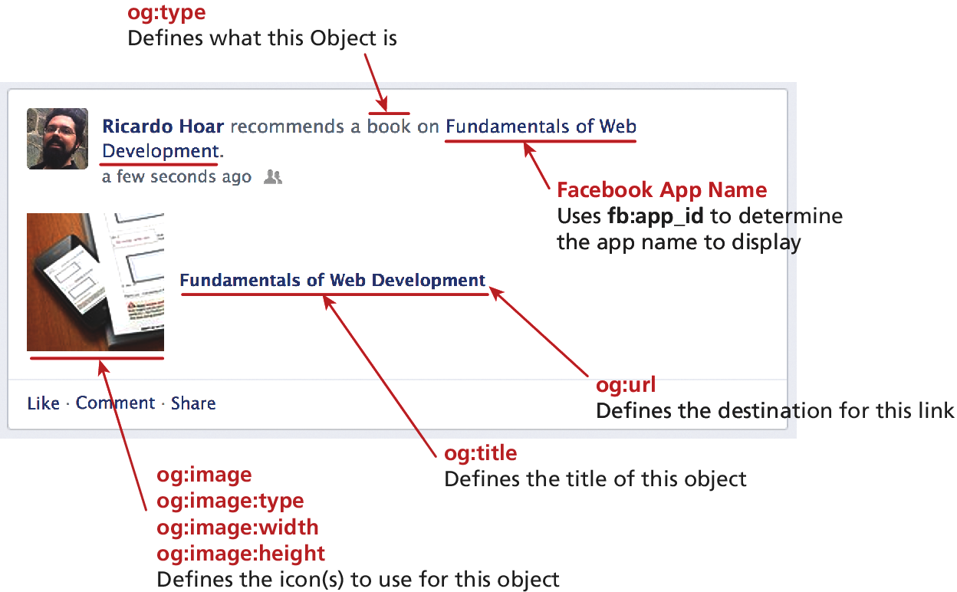
Open Graph
The resulting control in Facebook’s newsfeed

Slide 25
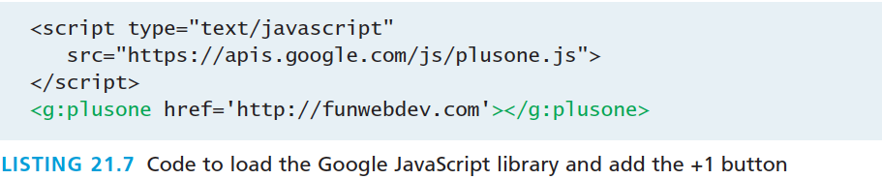
Google’s Social Plugins
+1
Google’s +1 button is similar to Facebook’s Like button
The code to add this button is below and can optionally use attributes that control the size and shape.

Slide 26
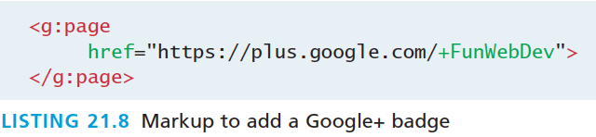
Google’s Social Plugins
Google Badge
Google’s badges can be created for pages, communities, or your own personal profile.
Google’s badges are configured in the dashboard so the code to add them is relatively easy

Slide 27
Google’s Social Plugins
Google Badge
Google’s badges can be created for pages, communities, or your own personal profile.
Google’s badges are configured in the dashboard so the code to add them is relatively easy

Slide 28
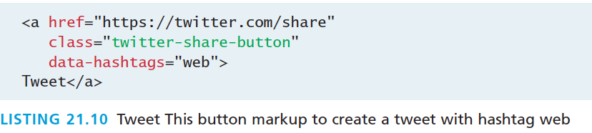
Twitter’s Widgets
Tweet Button
One the JavaScript libraries are loaded the Tweet This Button can be placed anywhere in the page using code below. When clicked the lodded in twitter user will tweet about the story at this URL.

Slide 29
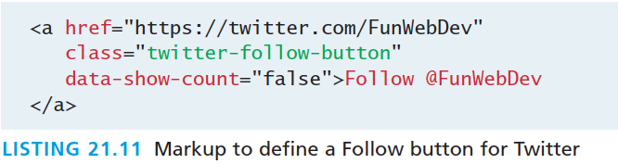
Twitter’s Widgets
Follow Me Button
The twitter follow button is equally simple and lets users follow your account on twitter.

Slide 30
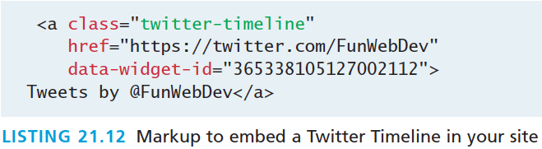
Twitter’s Timeline Widget
A feed of recent tweets
The code uses not only the user’s Twitter URL, but an additional field that cannot simply be guessed:
the data-widget-id field.
Twitter generates this field only when requested by a user through the web interface

Slide 31
Twitter’s Timeline Widget
Interface to generate the timeline widget

Slide 32
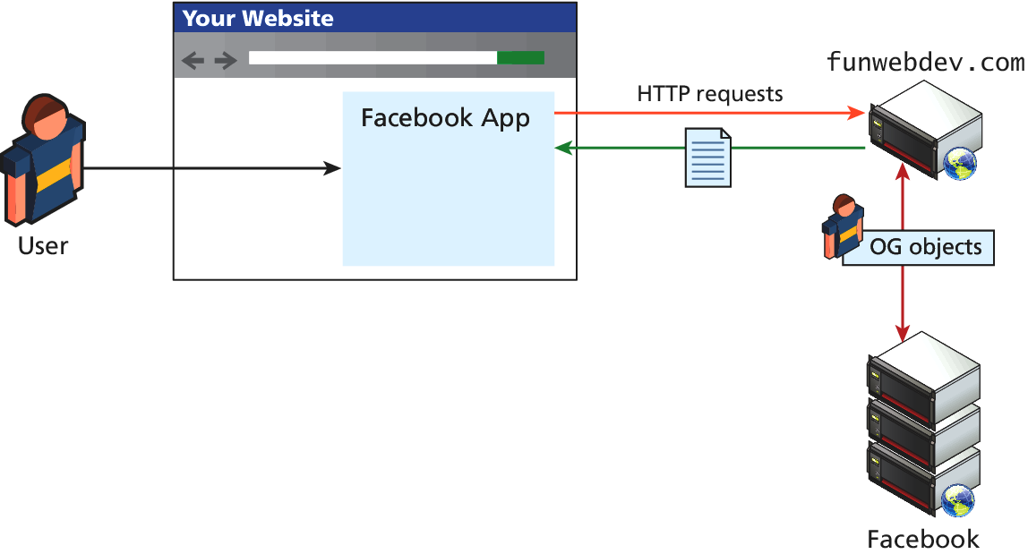
Advanced SN Integrations
Facebook game anyone?
To integrate more completely , you will have to make use of server-side APIs, which allow your server to act as an agent on behalf of users logged in through your site.

Slide 33
Monetize Your Site With ads
Section 3 of 5

Slide 34
Web Advertising
If your site ever gets big enough, or is sufficiently local, you can create and manage your own client accounts through your own home brew–advertising network.
The vast majority of monetization is done using the easy to use Ad Networks.
In the ad network, there are three classes of participant:
Advertisers (looking to pay money to have ads seen)
Website owners (looking to make money by showing ads)
The ad network

Slide 35
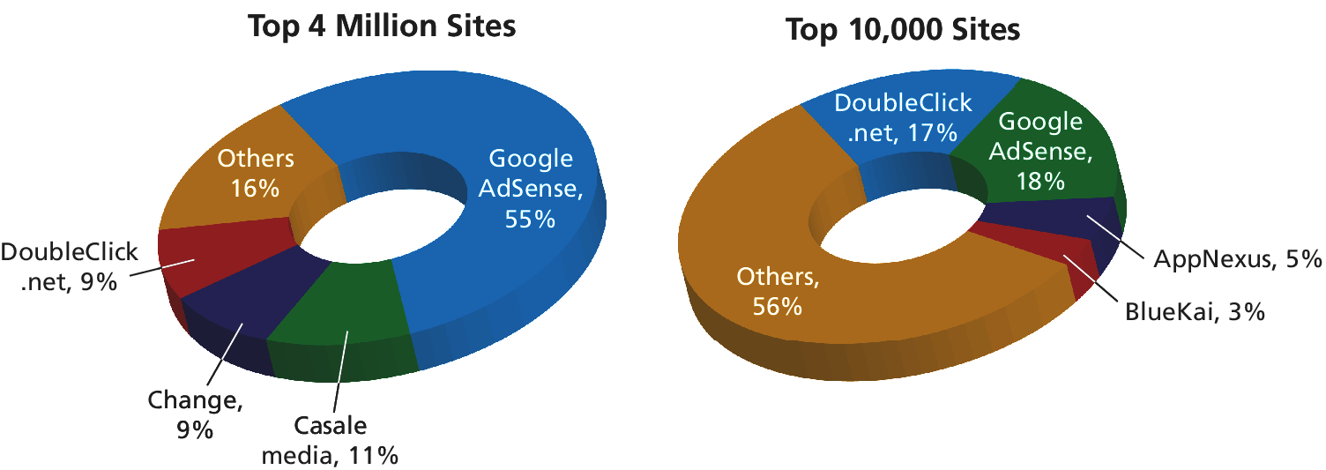
Web Advertising
Ad Networks

Slide 36
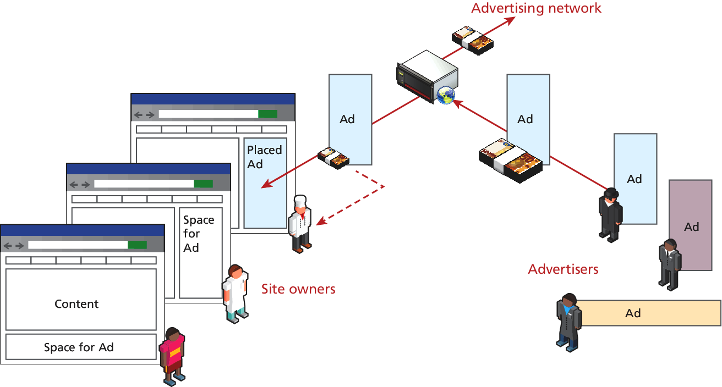
Web Advertising
Ad Networks

Slide 37
Types of Ad
3 major types in ad networks
Graphic ads are the ones that serve a static image to the web browser. The image might contain text and graphics, enticing the user to click the ad, which will direct them to a URL.
Text ads are low bandwidth, since they are entirely text-based. Like graphic ads, they too encourage the user to click and be directed to a destination URL.
Dynamic ads are graphic ads with additional moving parts. This can range from a simple animated GIF graphic ad all the way up to complex Flash widgets or JavaScript

Slide 38
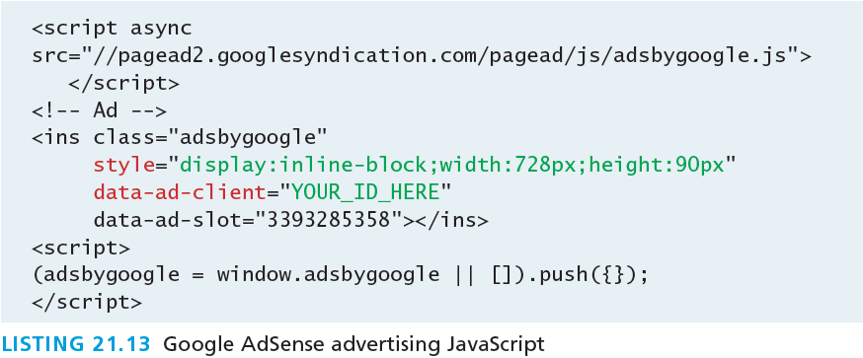
Putting ads on your page
Ad Networks
Getting your own particular code with your credentials and selections is normally done through the web portal that controls your account. Each particular advertising network is different, they usually have similar code snippets
you can clearly see some identifiers are required to link the ad with your account

Slide 39
Web Advertising Economy
No guarantee you get ads,
The website owner has three commodities at his or her disposal: Ad Views, Ad Clicks, and Ad Actions.
An Ad View (or impression) is a single viewing of an advertisement by a surfer. It is based on one loading of the page and although there may be multiple ads in the page, an impression is counted for each one.
An Ad Click is an actual action by a surfer to go and check out the URL associated with an ad.
An Ad Action is when the click on the ad results in a desired action on the advertiser’s page. Advertisers may pay out based on a successful account registration, survey completion, or product purchase, to name but a few.

Slide 40
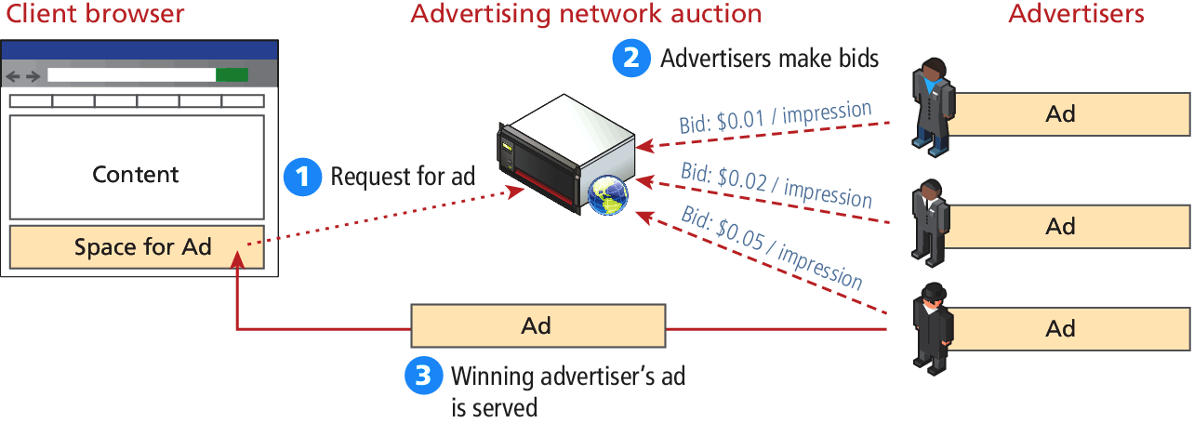
Web Advertising Economy
No guarantee you get ads,
With these commodities in mind, advertisers can pay for their ads using a combination of Cost per Click, Cost per Mille, and Cost per Action settings.
Auctions match up ad spaces and bidders

Slide 41
Web Advertising Economy
It’s fair enough
As a publisher of ads on your site, you have almost no control over what ads appear.
You cannot simply demand 100 dollars per click on your website about hamsters.
Conversely an advertiser should not be able to get one-penny ads on your successful site, if the demand from better advertisers willing to pay more is high.

Slide 42
Web Advertising Economy
Some common strategies for bidders
The Cost per Click (CPC) strategy is to decide how much money a click is worth, regardless of how many times it must be displayed.
Cost per Mille (CPM) means cost per thousand impressions/views of the ad. Obviously this rate is lower than a CPC rate, since not every impression results in a click
The Click-through Rate (CTR) is the percentage of views that translate into clicks. A click-through rate of 1 in 1000 (0.1) is fairly normal in search engine networks
Cost per Action (CPA) relates the cost of advertisement to some in-house action like buying a product, or filling out a registration form.

Slide 43
Marketing Campaigns
Section 4 of 5

Slide 44
Email Marketing
Some things are not allowed
Done poorly, email can be marked as spam, which can have negative consequences. Unsolicited emails sent in bulk are illegal in many jurisdictions!
In general, you can only target customers who have opted in to receiving such messages.
Every email campaign should contain a one-click mechanism to allow recipients of your messages to opt out of future emails.

Slide 45
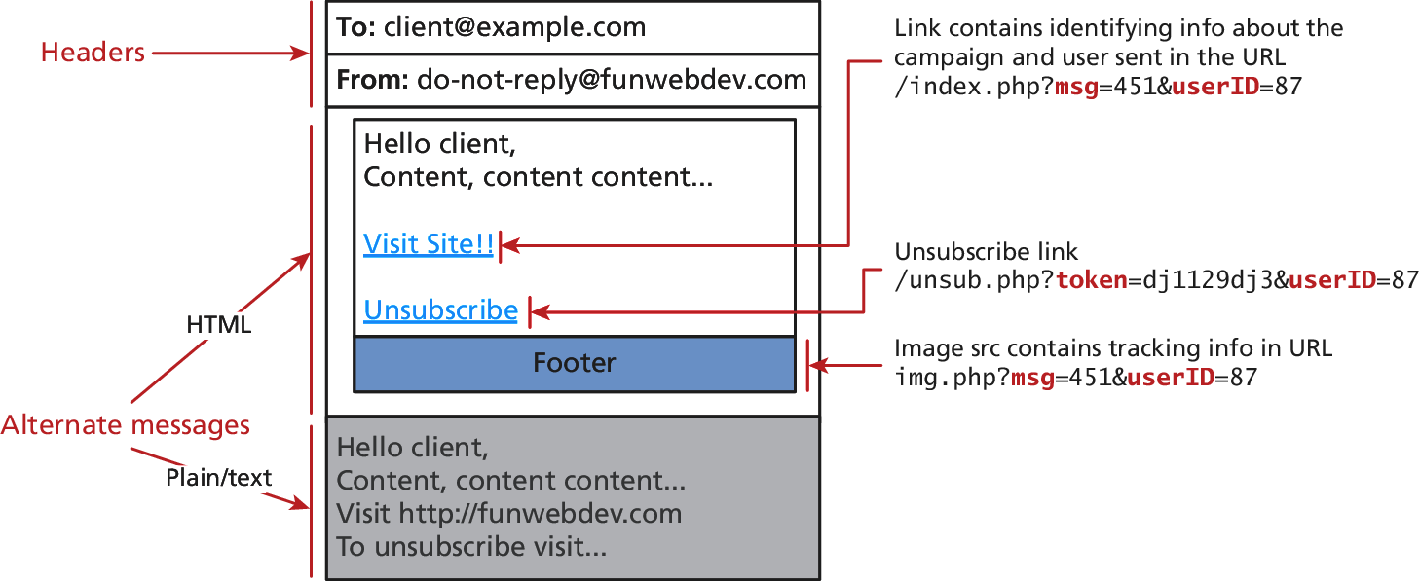
Email Marketing
Automated Scripts
The features of a good email are
well-formatted headers,
alternate versions including HTML,
opt-out links, and
tracking images to help measure performance.

Slide 46
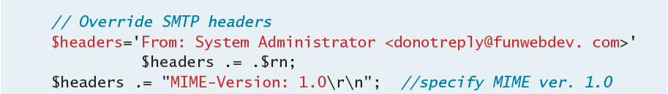
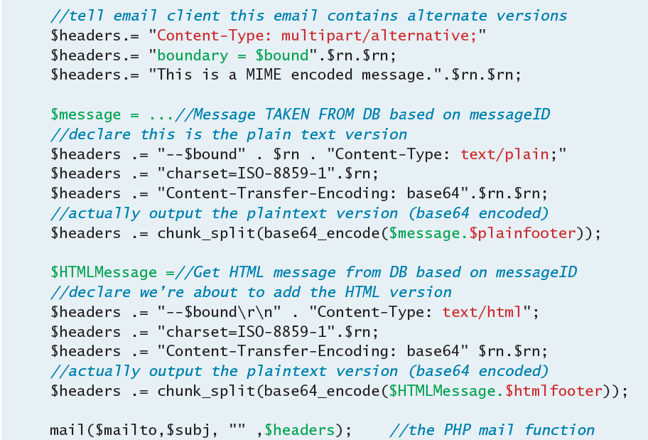
Email Marketing
Integrating email into a custom web application allows you full control

Slide 47
Tracking Email
Did they read my important email?
Just because an email is sent does not mean it was read.
A good technique for tracking reads is to embed graphics
img.php?msg=$messageID&userID=$accountID
Now when the message is read that image is requested and we use that to know which campaign it was from and who it was to.

Slide 48
Scheduled Mail Campaigns
I swear this is not a robot
One technique to try and engage existing customers is to set up a series of emails ahead of time that get sent to each user after a specified period or action.
Timed emails are set up in advance for example, to send email one day after signing up, another after a week, and a third after 30 days
Action emails can be associated with user actions (or inactions) so that an email is sent, for example, a few hours after a purchase.

Slide 49
Physical World Marketing
QR Codes
URLs cannot be clicked in the physical realm, which severely limits how large of URLs you can print, and expect people to remember.
QR codes allow people with camera phones to snap a picture of the code in order to be directed to a URL.
These physical world hyperlinks store redundant information in the pixels of the image, so that even if partially damaged, they may be able to be deciphered.

Slide 50

Physical World Marketing
Example of an obscured code

Slide 51
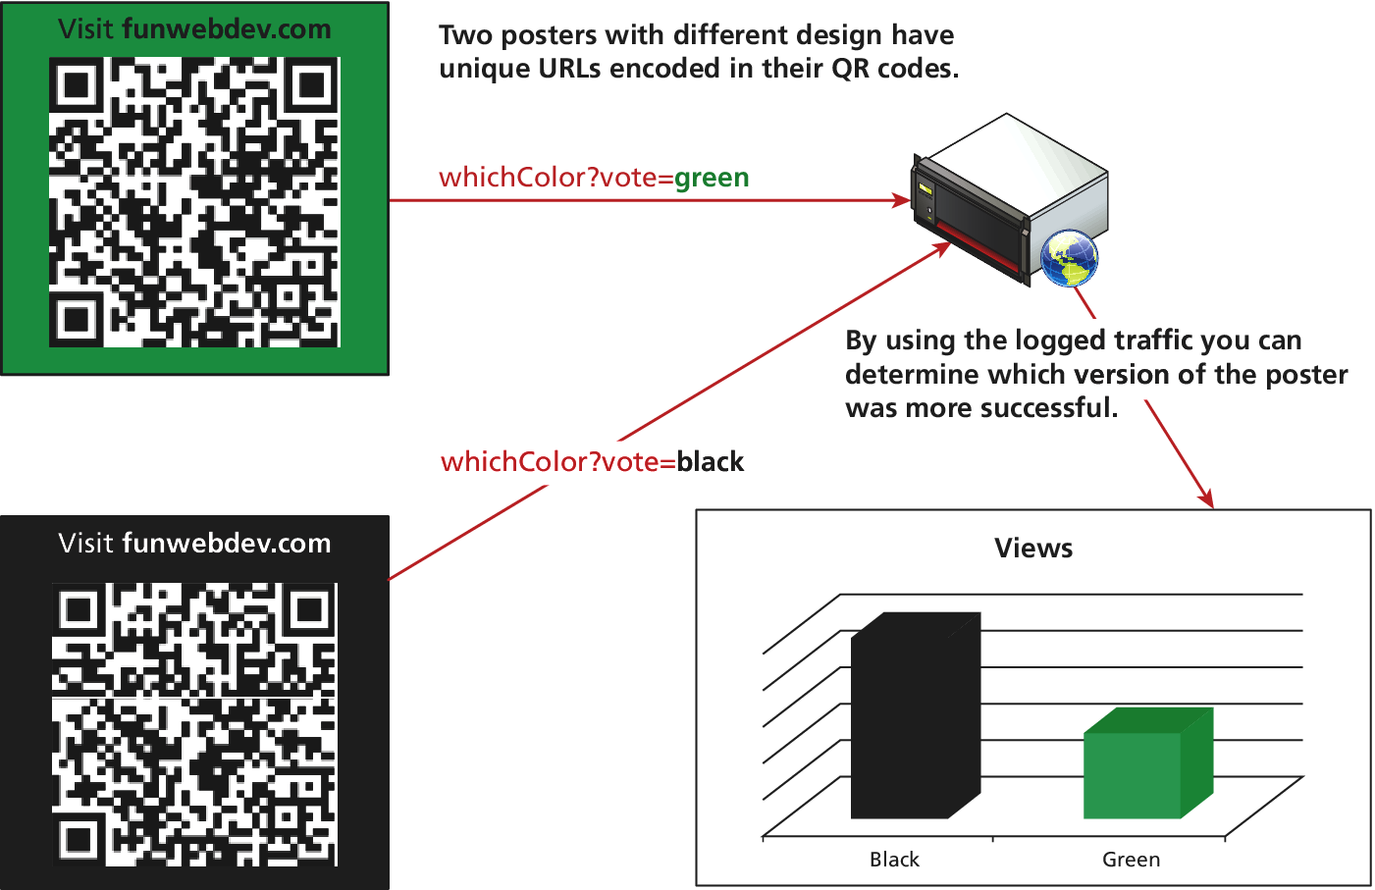
Tracking Physical Campaign
Using varied QR Codes/URLs

Slide 52
Working in Web Development
Section 5 of 5

Slide 53
Working in Web
So many choices
There are also several different types of companies that do web development, so it’s worth being aware of what types of choices you’ll have.
Working in the world of web development requires a team of people with various complementary skill sets and some areas of overlap and cooperation. You will learn a little about those other roles to help see situate your contribution.

Slide 54
Types of Web Development Companies
Hosting Companies or data centers offer many employment opportunities, especially related to hardware, networking, and system administration roles.
Design companies are at the opposite end of the spectrum, with almost no technical positions available. These firms will provide professional artistic and design services that might go beyond the web and include logos and branding in general.

Slide 55
Types of Web Development Companies
Website Solution Companies focus on the programming and deployment of websitesfor their clients. There are technical positions to help manage the existing sites as well as development jobs to build the latest custom site.
Vertically integrated companies combine hosting, design, and solutions into one company. This allows these companies to achieve economies of scale and appeal to the nontechnical clients who can go there for all their web-related needs, large or small.

Slide 56
Types of Web Development Companies
Start-up ventures in web development have been some of the biggest success stories in the business world. The smaller companies will require real generalists who can take on any role from system administrator through to lead developer.
Internal Development. Many companies have lots of internal data they would not share with outsiders and thus prefer in-house expertise for the development of web interfaces and systems to manage and display that confidential data.

Slide 57
Roles and Skills
It takes a village
Hardware/Network Architect
System Administrator
Database Administrator
Developer/Programmer
Tester
Security Consultant/Expert
Software Engineer
Nontechnical Roles

Slide 58
What You’ve Learned
1
2
Social Networks
Social Network Integration
3
4
Monetizing your site with Ads
Marketing Campaigns
5
Working in Web Development

